Slide 1

Unit - III Introduction to ARM
Reference:
Andrew N. Sloss, Dominic Symes, Chris Wright, ARM System Developer’s Guide: Designing and Optimizing System Software, Elsevier Inc., 2004.

Slide 2
Microprocessors vs. Microcontrollers
General Purpose Microprocessors
Microcontrollers (MCUs)

Slide 3
RISC DESIGN PHILOSOPHY
RISC is a design philosophy aimed at delivering simple but powerful instructions that execute within a single cycle at a high clock speed
RISC philosophy is implemented with four major design rules
Instructions — RISC processors have a reduced number of instruction classes. These classes provide simple operations that can each execute in a single cycle
Pipelines — The processing of instructions is broken down into smaller units that can be executed in parallel by pipelines
Registers — RISC machines have a large general-purpose register set. Any register can contain either data or an address
Load-store architecture — The processor operates on data held in registers. Separate load and store instructions transfer data between the register bank and external memory

Slide 4
Background of ARM
ARM was formed in 1990 as Advanced RISC Machines Ltd., a joint venture of Apple Computer, Acorn Computer Group, and VLSI Technology
Unlike many semiconductor companies, ARM does not manufacture processors or sell the chips directly
ARM licenses the processor designs to business partners
In 1991, ARM introduced the ARM6 processor family, and VLSI became the initial licensee
Subsequently, additional companies, including Texas Instruments, NEC, Sharp, and ST Microelectronics, licensed the ARM processor designs
Based on the ARM low-cost and power-efficient processor designs, these partners create their processors, microcontrollers, and system-on-chip solutions.
This business model is commonly called intellectual property (IP) licensing.

Slide 5
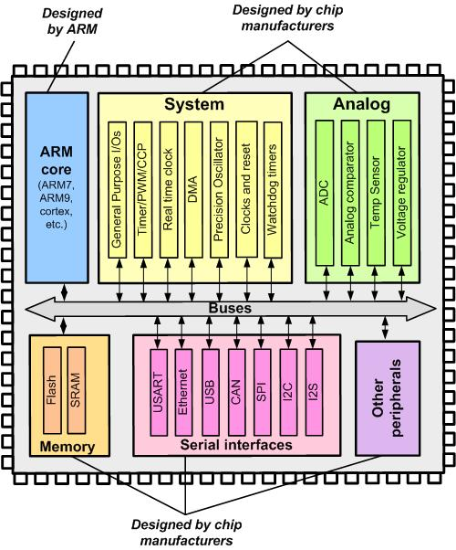
Arm MCUs of Different Companies
The same CPU and Assembly Language
Different Peripherals

Slide 6
ARM DESIGN PHILOSOPHY
ARM processor has been speciﬁcally designed to be small to reduce power consumption and extend battery operation
Single-chip solution, the smaller the area used by the embedded processor, more available space for specialized peripherals.
High code density
Incorporated hardware debug technology
ARM core is not a pure RISC architecture because instruction set differs from the pure RISC
Variable cycle execution for certain instructions
Inline barrel shifter leading to more complex instructions
Thumb 16-bit instruction set
Enhanced instructions (DSP Functions)

Slide 7
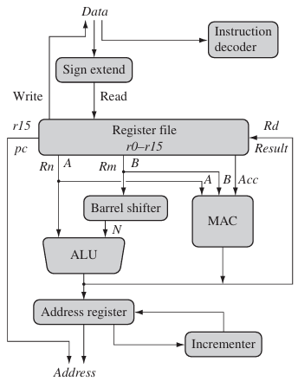
ARM core architecture

Slide 8
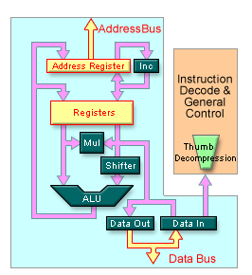
ARM7TDMI core architecture

Slide 9
ARM Nomenclature
ARM{x}{y}{z}{T}{D}{M}{I}{E}{J}{F}{-S}
x—family
y—memory management/protection unit
z—cache
T—Thumb16-bit decoder
D—JTAG debug (IEEE 1149.1 Standard Test Access Port to send and receive debug information between the processor core and test equipment)
M—fast multiplier
I—Embedded ICE macrocell (allows breakpoints and watchpoints to be set)
E—enhanced instructions (assumes TDMI)
J—Jazelle (allows to execute Java bytecode as third execution state)
F—vector floating-point unit
S—synthesizible version (can be compiled into a form easily used by EDA tools)

Slide 10
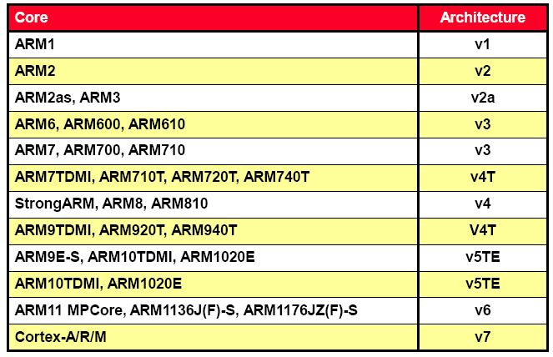
Architecture Revisions

Slide 11
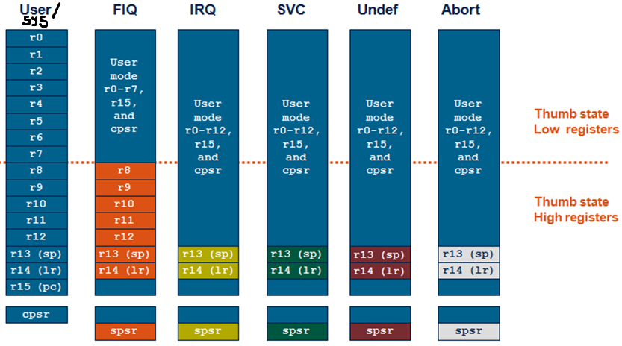
ARM Registers

Slide 12
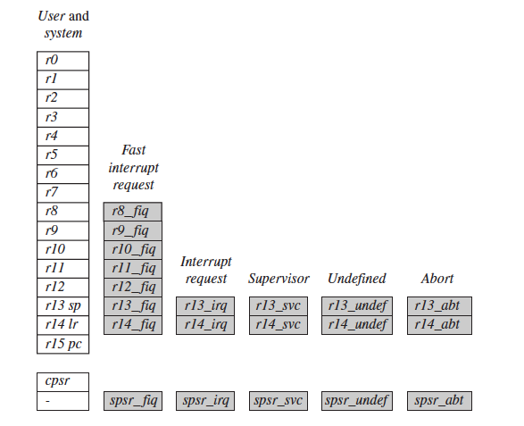
ARM Registers

Slide 13
ARM State Registers
The ARM state register set contains 16 directly-accessible registers, r0 to r15
Registers r0 to r12 are general-purpose registers used to hold either data or address values
Registers r13, r14 and r15 have the following special functions
An additional register, the Current Program Status Register (CPSR), contains condition code flags, and the current mode bits
Register r13 is traditionally used as the Stack Pointer (SP) and stores the head of the stack in the current processor mode.
Register r14 is called the Link Register (LR) and is where the core puts the return address whenever it calls a subroutine.
Register r15 is the Program Counter (PC) and contains the address of the next instruction to be fetched by the processor.

Slide 14
Features of ARM Instruction Set
Inline barrel shifter
MOV R7, R5, LSL #2 ; R7 = R5*4 = (R5<<2)
Optional update of Status bits in Program Status Register
MOVS R0, R1, LSL #1 ; C flag is updated in CPSR because the S suffix is present
Conditional execution
ADDCS R0, R1 ; if (CF==1) then R0 = R0 + R1
Three register addressing
SUB R2, R1, R0 ; R2 = R1 – R0

Slide 15
Examples for Advanced ARM Instructions
Multiple Load/Store
LDMIA r0!, {r1-r3}
PRE POST
mem32[0x80018] = 0x03 r0 = 0x00080010 r0 = 0x0008001c
mem32[0x80014] = 0x02 r1 = 0x00000000 r1 = 0x00000001 mem32[0x80010] = 0x01 r2 = 0x00000000 r2 = 0x00000002
r3 = 0x00000000 r3 = 0x00000000
Multiply & Accumulate
MLA R10, R5, R3, R1 ; R10 = (R5 * R3) + R1
Multiply & Subtract
MLS R10, R5, R3, R1 ; R10 = (R5 * R3) - R1

Slide 16
THUMB State Registers
The Thumb state register set is a subset of the ARM state set.
The programmer has direct access to:
Eight general registers, r0–r7
PC
Stack Pointer (SP)
Link Register (LR)
CPSR.
Thumb state r0–r7, and ARM state r0–r7 are identical
Thumb state CPSR and SPSRs, and ARM state CPSR and SPSRs are identical
Thumb state SP maps onto ARM state r13
Thumb state LR maps onto ARM state r14
The Thumb state PC maps onto the ARM state PC (r15).

Slide 17
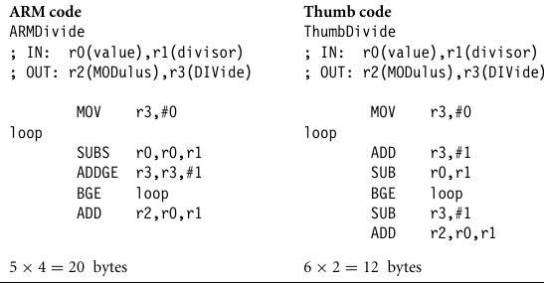
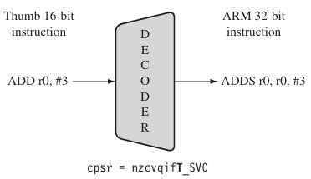
ARM vs THUMB State

